Slide 1
Project Coronavirus Prevention System
Group 24
Emanuel Cicortas Computer Engineering
Dat Nguyen Computer Engineering
Ha Tran Electrical Engineering
Phuong Anh Vu Computer Engineering
Senior Design 2: Critical Design Review
Notes:
Good morning/afternoon. We are group 24 and our project is the Coronavirus Prevention System

Slide 2
Meet the Team:
Emanuel Cicortas
Dat Nguyen
Responsibilities:
Jetson Nano
ML model training
Responsibilities:
Microcontroller
Power delivery
Ha Tran
Phuong Anh Vu
Responsibilities:
Power delivery
System housing
Responsibilities:
Database server
ML model training
Speaker: Dat
Notes:
Let's go over our line up.
We have Emanuel, myself, Dat, Ha, and Phuong Anh. Our responsibilities are listed on the slide

Slide 3
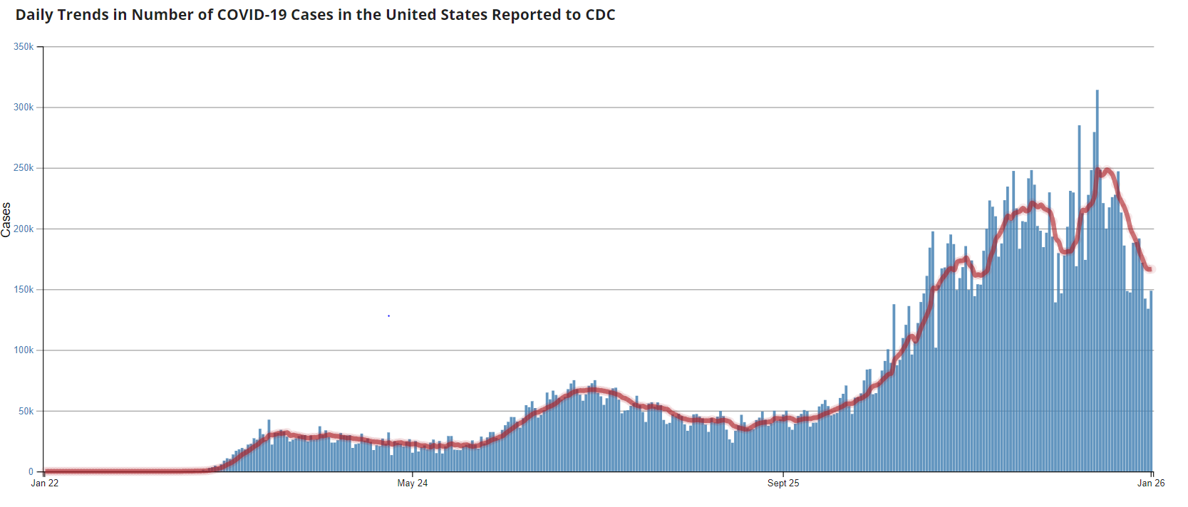
Motivation
Speaker: Dat
Notes:
Our motivation is rather straight forward. We simply wanted to contribute to the global concern of preventing the spread of the novel Coronavirus pandemic

Slide 4
Motivation
COVID- 19 has been spreading quickly since November 2019
More than 400,000 people have lost their lives
WHO and public health officials recommend wearing mask and social distancing of 6-feet or more to reduce the risk of transmission
Many public places are vulnerable to become a catalyst of spreading the virus: restaurants, schools, supermarkets, etc
To build a low cost and effective robot that uses machine learning to detect faces of people without masks
Automatically open its storage compartments for non-mask wearing person to get a face mask
Speaker: Dat
Notes:
Since the Covid19 first started in Wuhan, China back in November of 2019, it has spread rapidly. Now, there has been more than 400k reported deathes in the United States alone
The WHO and many health officials have said that wearing mask and keeping a 6-feet social distance is the best way to reduce transmission
However, many public places are extra vulnerable to become a catalyst of spreading the virus like restaurants, schools, supermarkets, bars, etc
Thus, We want to build a low cost and effective robot that uses ML to detect faces of people without masks.

Slide 5
Objectives
Aims to provide a cost-effective and easy to use system to distribute single-use masks
Rely on simple tried-and-true components and designs
Two main functions: Detection & Data collection
By gathering user data, we will be able to prepare user statistics on health and behaviors
Speaker: Dat
Notes:
- Our necessity-based Coronavirus Prevention system aims to provide a cost-effective and easy to use system to distribute single-use masks
- By relying on simple try-and-true components and designs, we try to cut the cost of the production of the robot to as low as possible
- Our machine has 2 main functions: detection and data collection
- It will first determine if the person standing in front of it is wearing a mask. If that person is not wearing a mask, then the machine housing door will open, allowing the user to fetch a mask. While all of that is happening, the data of the mask-wearing status will be logged into our database.
- By gathering user data, we will be able to prepare user statistics on health and behaviors. Such data will be extremely valuable to scientists and researchers, who are trying to study trends and correlations

Slide 6
Requirements
Requirement | Requirement Deliverability
The production cost of the entire system will not exceed $1000 in investment. | The components required for the development of the final product will mostly be second-hand to save on cost.
The system shall be sturdy and reliable enough to sit in one spot for years on end. | The body of the system shall be built out of acrylic/hard plastic to provide both a sturdy foundation and cut back on material cost.
The resolution of the camera shall be no less than 1080 interlaced resolution | We shall purchase the correct device that meets this requirement
The power delivery shall be able to produce at least 30 Watts under sustained load | We shall design the power delivery circuit and use quality products that meets this requirement
Requirement | Requirement Deliverability
The microcontroller shall be able to interact with at least 5 devices at once​ | We shall purchase the correct device that meets this requirement​
The door-opening-motor shall be able to move the door in the 90-degree range | The software that controls the motor shall be tuned manually to meet this requirement
The range sensor shall have the range of at least 1 meters​ | We shall buy the correct device that meets this requirement​
The image processor shall be able to accurately process 1 image at a time​ | We shall program the processor and design the algorithm in such a way that this requirement is met​
The image processor shall support a form of database either in the MySQL fashion or simply as a text file to store data​ | We shall program the processor correctly to meet this requirement​
Speaker: Dat
Notes:
Here are the list of our requirements:
We want our machine to be less than $1000 in production cost, and so far, we have been way below the limit
We want the system to have sturdy build frame, high resolution camera, a robust power delivery that can provide at least 30W of sustained power load
We will also need a microcontroller for peripheral controls, a servo motor, a distance sensor, a relatively powerful image processor, and a database to store information

Slide 7
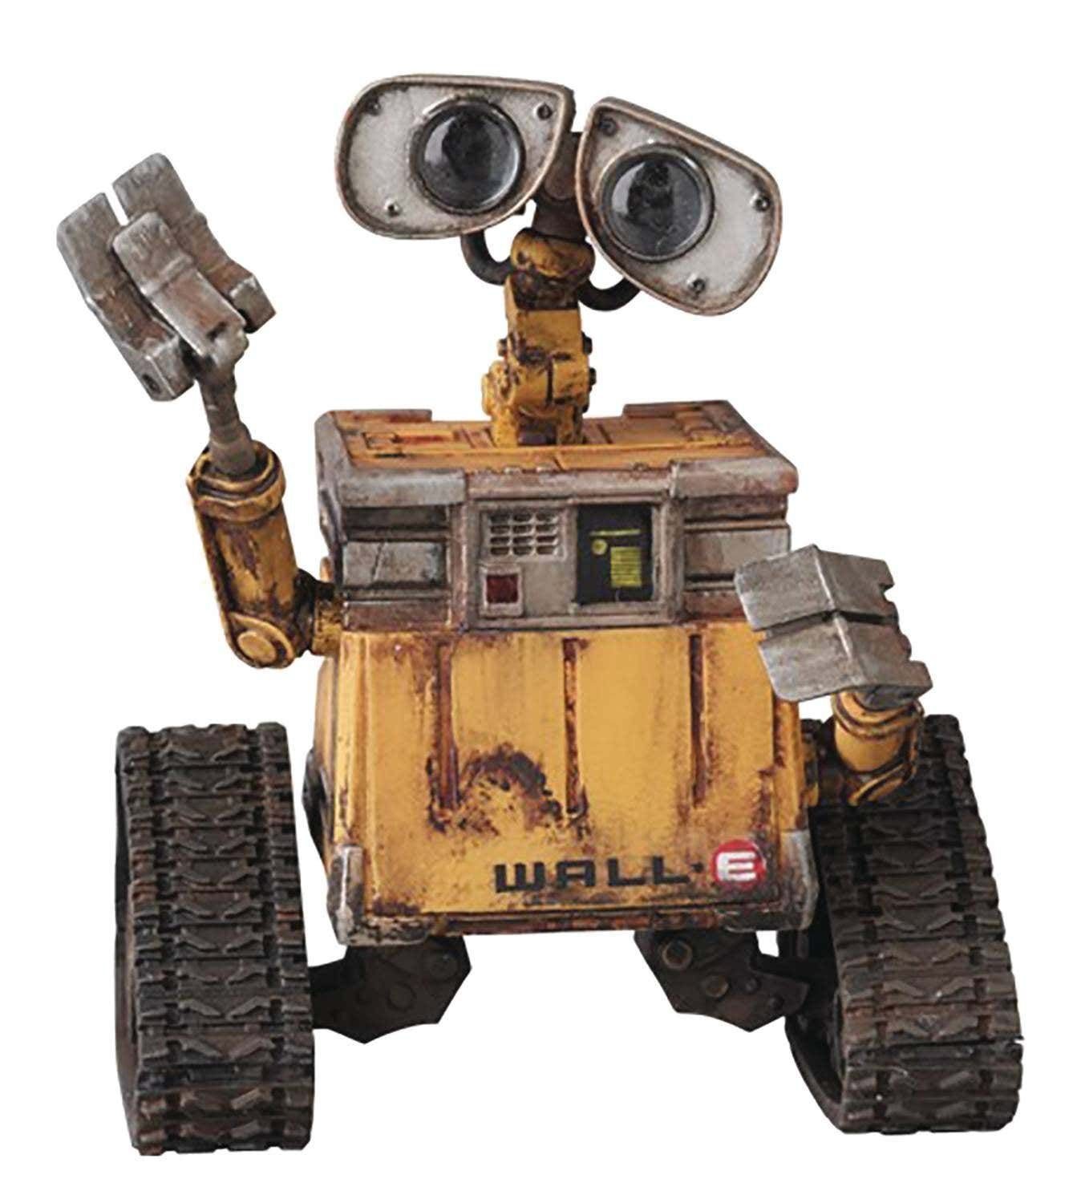
Specifications
Component | Specification
Wall Plug | USA type A plug standard (Compatible with type B sockets)
Power Delivery | 120V_{ac} at 60Hz input / 3.3V_{dc} and 5V_{dc} output
Full System Dimension | ~10 in x 10 in x 10 in
Weight | < 10 kg
Motor | Bidirectional
Microcontroller | Support multiple peripherals interfacing
Camera | 1080p+ resolution, supporting multiple image formats
Image Processor | ~500GFLOPS
Distance Sensor | >1-meter distance
Internal Storage | 128GB
Speaker: Dat
Notes:
These are our hardware specifications:
We will be using the Type A wall plug
Our power delivery unit will need to produce both a 3.3V and a 5V output
The dimension is 10x10x10 inches to give us ample amount of room to work in. Basically imagine a miniature Wall-E without arms and wheels
The system will be lightweight so that it can be easily moved from one play to another.
The motor used will need to be bidirectional
The microcontroller will need to be able to communicate with another device and control multiple peripherals at once
The camera needs to support high resolution imaging
The image processor needs to be powerful enough to process the image quickly
The distance sensor needs to be at least 1 meter in range
And the storage needs to be large enough to store a large amount of data

Slide 8
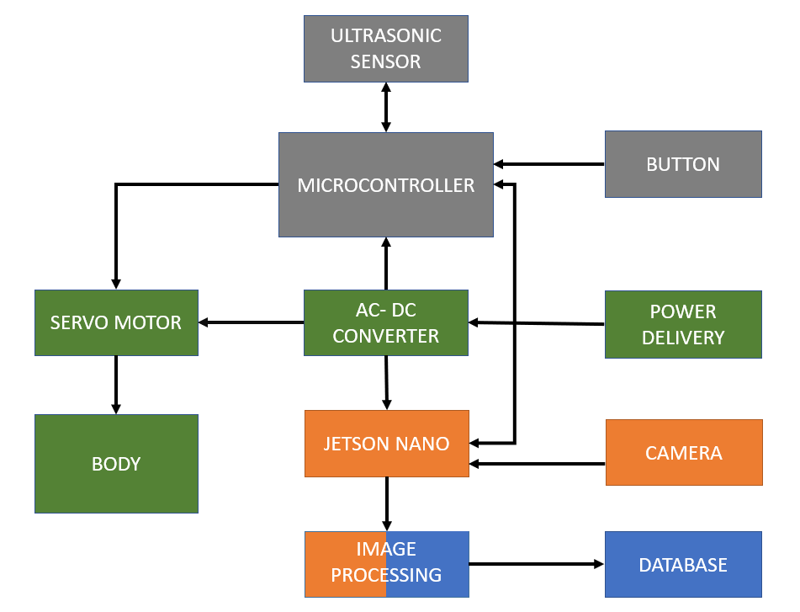
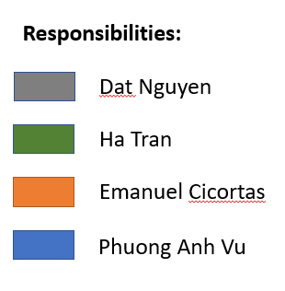
The System Overview
Hardware Block Diagram
Speaker: Dat
Notes:
This is our block diagram for the hardware portion. It's rather straightforward as you can see

Slide 9
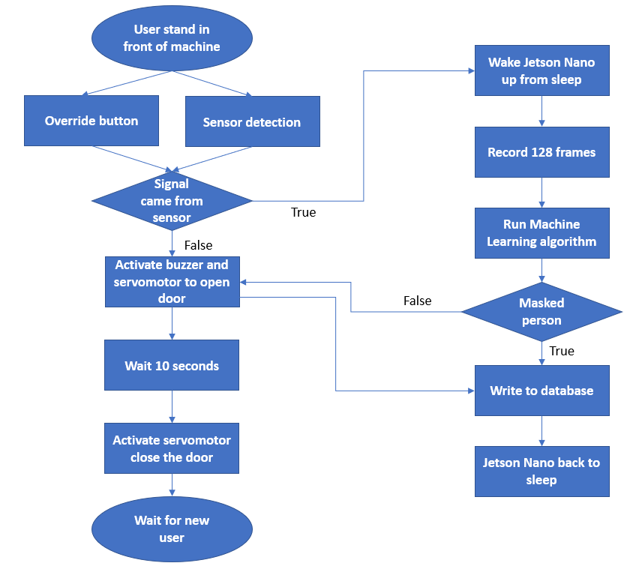
The Operation Flowchart
Initial universal sleep
Microcontroller activated by distance sensor or button
Microcontroller wakes Jetson Nano
AI processing sequence
Jetson Nano replies to microcontroller
If no mask is detected, motor is activated
Write result to database
Back to sleep
Speaker: Dat
Notes:
Here is the operational flowchart.
Initially, everything is at sleep to conserve power
The microcontroller is activated if either the distance sensor detects a person in range or if the button is pressed.
The microcontroller then wakes up the Jetson Nano to initiate the AI facial recognition sequence
Then, if no mask is detected, then the Jetson Nano will signal the microcontroller to open the door to the mask container so that the user may reach in and fetch a mask.
While all the mechanical stuff is happening, the Jetson Nano will log the facial recognition result into a local database
Then everything will go back to sleep
The push button is used as a fail-safe in case something is blocking the distance sensor from working properly

Slide 10
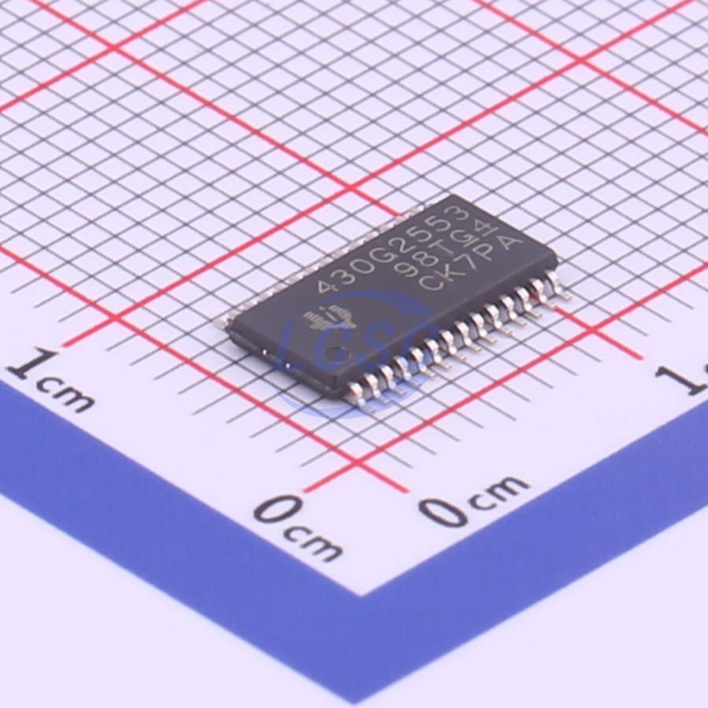
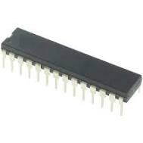
Controller
ATmega328
MSP430G2553
Cheap
PWM-capable
Can interface with another device
Muti-peripherals support
L293D motor driver
Speaker: Dat
Notes:
The microcontroller we went with is the Texas Instrument MSP430G2553. Before choosing it, we also considered the AtMgea328 as it has a very strong community support and many project examples that we can work off of. We needed something that could communicate with another device and can control many peripherals at the same time, and both of these fit the criteria. However, we ultimately decided to go with the MSP430 simply because was ever so slightly cheaper. There are also many MSP430 experts at the school, who we can seek help from in case we run into any problem like with Dr. Suboh, Dr. Abichar, and Dr. Richie
A problem we had programming the controller was that we could not get the motor to run. We even checked the oscilloscope for the PWM signal, and it was correct. We later learned that we need a motor driver to control the motor because the MSP430 does not supply enough current to turn on the motor. The motor driver's job is to relay the PWM signal form MSP to the motor while supplying the motor with additional current. The motor driver we went with is the TI L293D

Slide 11
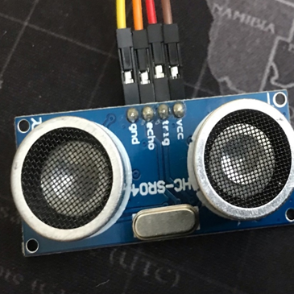
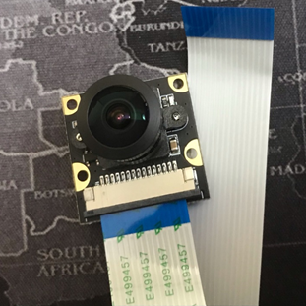
Peripherals
HC-SR04
Ultrasonic Sensor
IMX219
Camera Module
Cheap
Reliable
High resolution (3280 x 2464)
Cheap
Speaker: Dat
Notes:
Now let's talk peripherals. The servo motor we used is just a generic part from ebay. Aside from that, we have the HC-SR04 Ultrasonic sensor and the IMX219 camera module.
There were several types of distance sensor types that we could have used like the infrared sensor and the LiDAR sensor. However, since we do not know whether the machine will be used outdoor or indoor, using an infrared sensor may not be the best idea. And since we just need to detect a person within 1 meter of the machine, an expensive LiDAR is not necessary. The HC-SR04 is cheap and reliable, that's why we went with it
We are doing facial recognition, so we need a camera. Cameras can be found on the market at anywhere from a couple hundred to a few thousand dollars. We want something with high-resolution, that does not destroy our budget, so we decided to go with the IMX camera module. Compare to the conventional camera, the IMX219 module does not have an on-board image preprocessor. Because of that, at $22, it is roughly 50-70% cheaper than the mainstream alternatives. The module supports 3280 x 2464 image resolution, that's just a bit smaller than 4k in the horizontal aspect, but a bit larger in the vertical aspect.

Slide 12
Power Design
Components | Voltage Required | Rated Current | Power Consumed
MSP430 | 3.3V | 300mA | 0.99W
Ultrasonic Sensors | 5V | 2mA | 0.01W
Servo Motor | 3.5V | 550mV | 1.925W
Jetson Nano | 5V | 4A | 20W
Piezo Buzzer | 3.3V | 3mA | 0.01W
Total |  |  | 22.935W
Speaker: Ha
Notes:
Here is a quick breakdown of the power consumption of each part. In total, we have 22.935W that we need to supply for from the power delivery

Slide 13
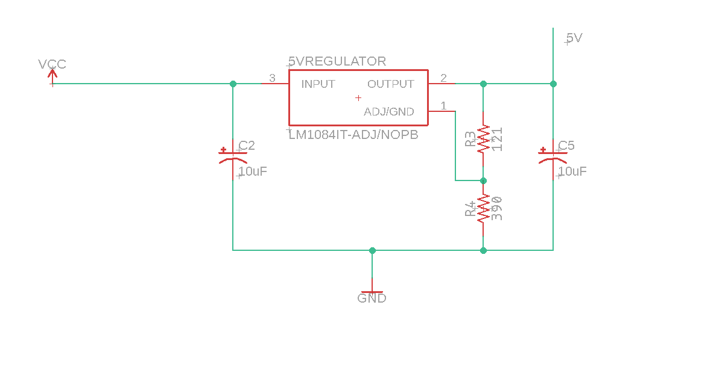
Power System 5V DC Regulator Circuit
PARAMETER | VALUE
Input Voltage | 12V
Output Voltage | 5V
Output Current | 5A
Load Regulation | 0.015%
Line Regulation | 0.1%
Temperature Range | -40- to +125°C
Speaker: Ha​

Slide 14
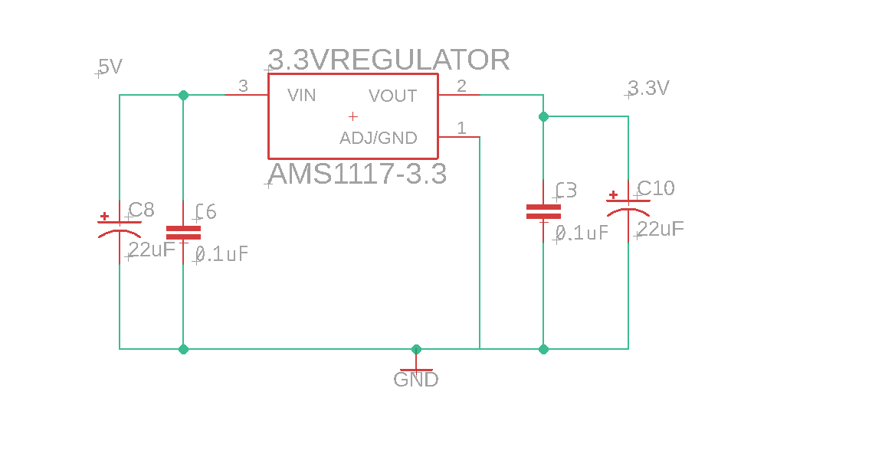
Power System
3.3V DC Regulator Circuit
PARAMETER | VALUE
Input Voltage | 5V
Output Voltage | 3.3V
Output Current | 1A
Load Regulation | 0.2%
Line Regulation | 0.4%
Temperature Range | -40- to +125°C
Speaker: Ha
Notes:
Our primary circuit design consists of 2 parts: 5V converter and 3.3V converter.
The components that were used for the 5V converter are: ...
The components that were used for the 3.3V converter are: ...
We chose the … and the … to regulate our output voltage because, according to TI's power supply design tool' WEBENCH Power Designer, the parts are upward of 90% efficient.
Initially, we had wanted to use linear regulators like the LM7805 for a more simplistic circuit design, but we found out later that theses parts are extremely inefficient, with 45-50% efficiency, so with switched to TI's design instead.

Slide 15
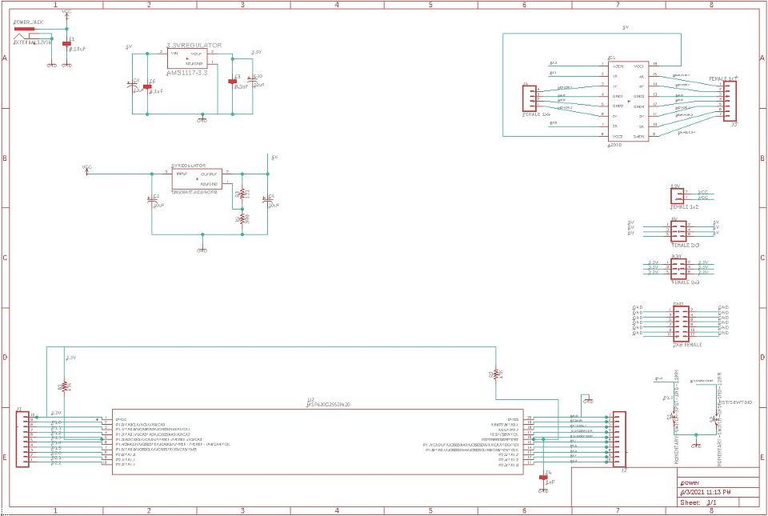
PCB Schematic
Speaker: Ha
Notes:
Here is our schematic for the PCB.
We will have an external power brick which converts 120Vac from the wall to more electronics friendly 12Vdc.
First, the system will take in 12Vdc from the power brick via the DC barrel jack (point to top left)
Then, the 12V will be forked to the 5Vdc converter and 3.3Vdc converter circuits to get the correct voltage that our components want
The 3.3V output will power the MSP430 microcontroller
The 5V output will power the motor driver that drives the servo motor that opens and closes the door to the system
The 5V output will also be providing power to the external Jetson Nano via the voltage output pins
The 5V output rail will be able to deliver up to 6Amps to satifsy whatever power the Jetson Nano may need

Slide 16
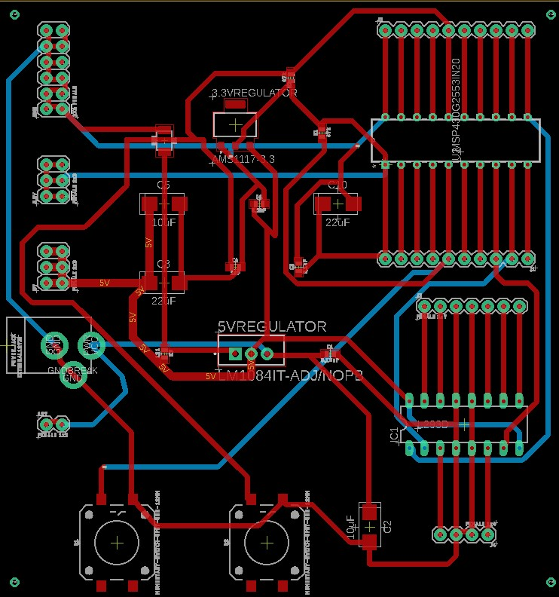
PCB design
Designed on Eagle
Two layers
Manufactured by JLCPCB
Speaker: Ha
Notes:
Here is our PCB board layout
The PCB has 2 layers and was designed on Autodesk Eagle
We were split between using JLCPCB and PCBWay to manufacture our PCB initially, so we sent our gerber files to both company to get the quotes. The PCBWay quote we got were a bit cheaper than from JLCPCB, so we went with PCBWay for the manufacturing. PCBWay also offers soldering service, so we made good use of that and have them solder the components for us as well. However, PCBWay's board came in defective, so we had to reorder from JLCPCB

Slide 17
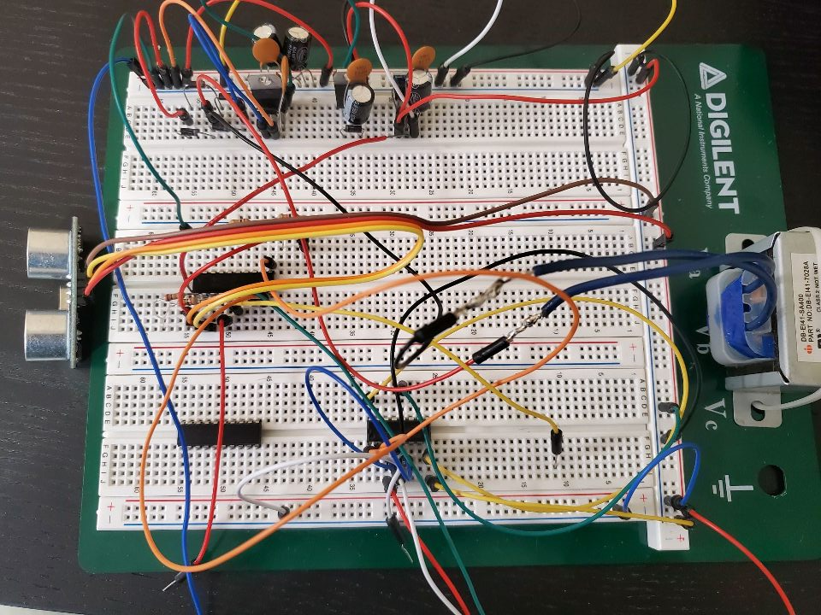
Power System Implementation
Speaker: Ha​

Slide 18
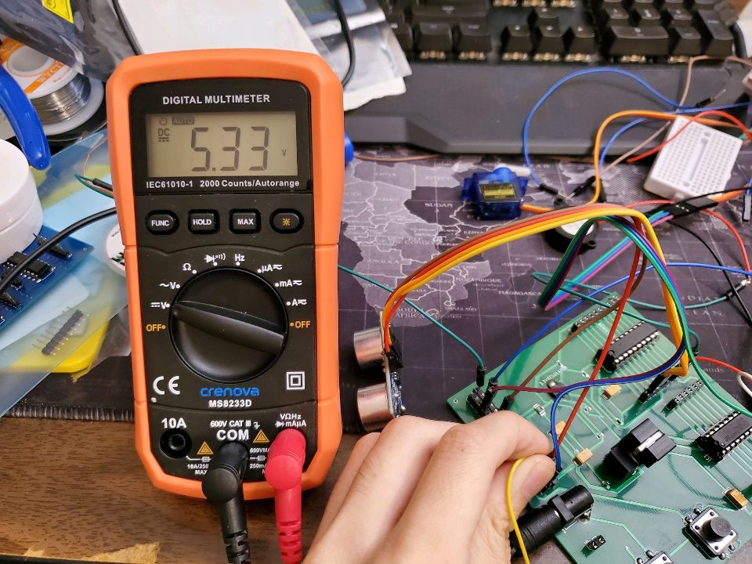
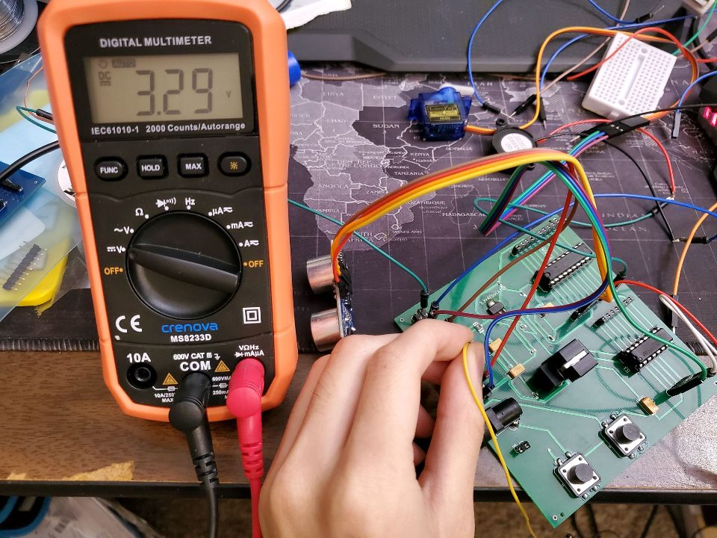
PCB Testing
Speaker: Ha​

Slide 19
Face & Mask Detection
Requirements:
Hardware:
I/O to MCU.
Camera for video.
Power suitable for AI video inference.
Software:
Determine number of masks/no-masks in image
Serial Tx/Rx with MCU.
Statistics database support
Speaker: Emanuel

Slide 20
Face & Mask Detection
 | Asus Tinker S | Jetson Nano | Raspberry Pi 4
CPU | 4-core ARM A17 | 4-core ARM A57 | 4-core Broadcom BCM2711
GPU | 4-core ARM Mali-T760 | 128-core Maxwell | None
IO Count | 28 Pins | 40 Pins | 40 Pins
Camera Support | USB only – no MIPI drivers | 2 MIPI CSI or USB | 2 MIPI CSI or USB
Power Draw | 2A @ 5V | 4A @ 5V | 3A @ 5V
Price | $100 | $90 | $35
Hardware Responsibilities:
Camera Input
MIPI-based for speed, $$$
Processing power
Strong GPU, CPU
I/O
Future functionality, peripherals
Power Draw
Efficiency
Speaker: Emanuel

Slide 21
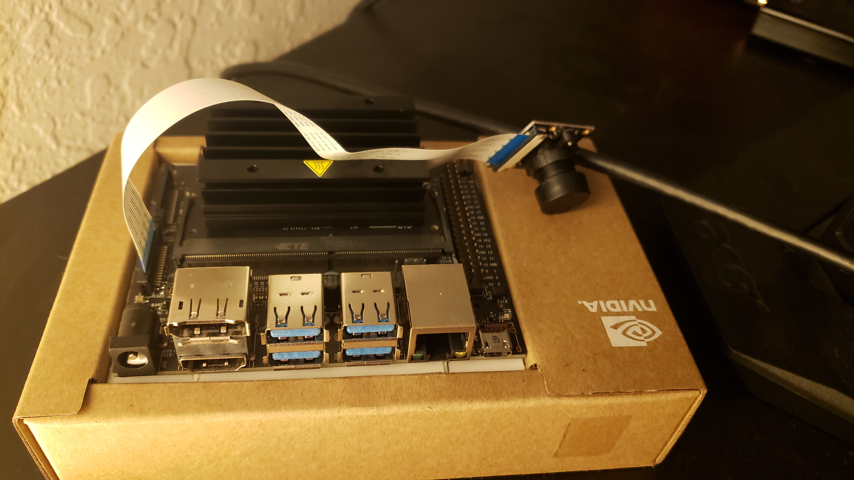

Slide 22
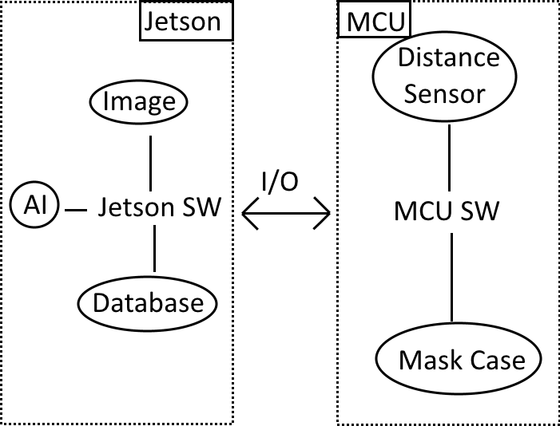
Face & Mask Detection
Software Responsibilities:
Monitor & Drive I/O
To/from MCU
Capture image data
Run AI inference
Maintaining database
Timestamp, metadata, etc.
Speaker: Emanuel

Slide 23
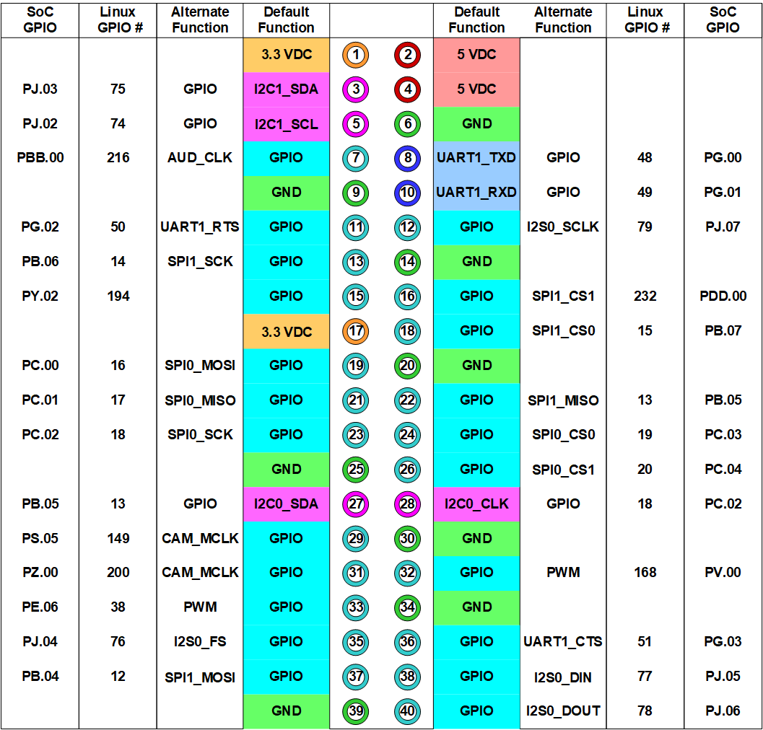
Face & Mask Detection: I/O
Software/Hardware Interfacing
Tx/Rx with MCU
Python Modules:
Jetson.GPIO
serial
Jetson Power Rails:
5VDC (pins 2, 4)
GND (pin 6)
Speaker: Emanuel

Slide 24
Face & Mask Detection: Algorithm
OpenCV with TensorFlow/Keras
Training performed with TF/Keras, inference with OpenCV
Requires in-depth knowledge for writing training, inference Python scripts
More tunable parameters for performance
NVIDIA TLT & Deepstream
Model trained by Transfer Learning Training, inference with Deepstream
Details further abstracted from user, easy to use and quick to set up. Not as customizable.
Jetson-specific, performance optimized
Speaker: Emanuel

Slide 25
Face & Mask Detection: Training
Data Preparation
(KITTI, TFRecords)
Mask Detection Model
Training
Pruning
Re-Training
Pre-Trained ResNet-18 Model
Speaker: Emanuel

Slide 26
Face & Mask Detection: Deploy
Log Result in Statistics
Generate, Connect GStreamer Pipeline
Wait For MCU Start Condition
Run Pipeline, Inference
Inform MCU of No-Masker
Mask Detection Model
Speaker: Emanuel

Slide 27
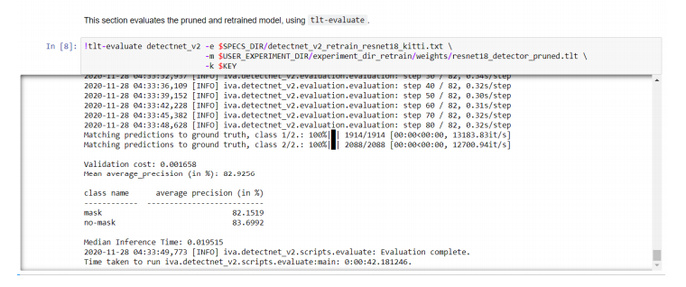
Face & Mask Detection: Algorithm
Requirements
Datasets for faces with masks and without masks
Image input resolution: 960x544
Network Architecture
NVIDIA DetectNet_v2 head
ResNet18 backbone
Result:
High accuracy on face without mask
Training accuracy evaluations is up to 84%
Speaker: PA

Slide 28
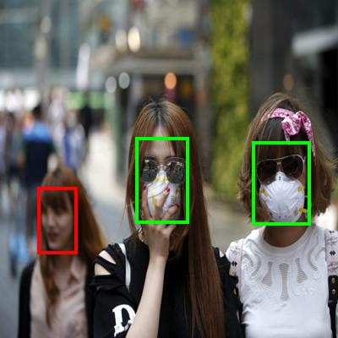
Speaker: PA

Slide 29
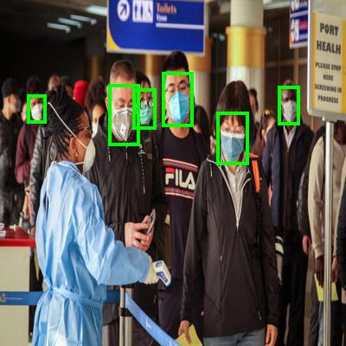
Speaker: PA

Slide 30
LAMP Stack
LINUX (Operating System): Free and Open-source operating system
This Photo by Unknown Author is licensed under CC BY-SA
Flexibility
Offers flexibility to build and deploy the applications as desired
Customization
Components are open-source that provides huge range of modules and functionalities
Community Support
Huge community from Internet
Easy to learn
APACHE (The Web Server)
This Photo by Unknown Author is licensed under CC BY-NC
MySQL (The database)
This Photo by Unknown Author is licensed under CC BY-ND
Python (The language)
This Photo by Unknown Author is licensed under CC BY-SA
Speaker: PA

Slide 31
Database system
Primary key is generated with unique number each time a person come through the system
Person coming toward the camera will be labeled as “Mask” or “No mask”
Store date and time of a person using format YYYY-MM-DD hh:mm:ss
Speaker: PA

Slide 32
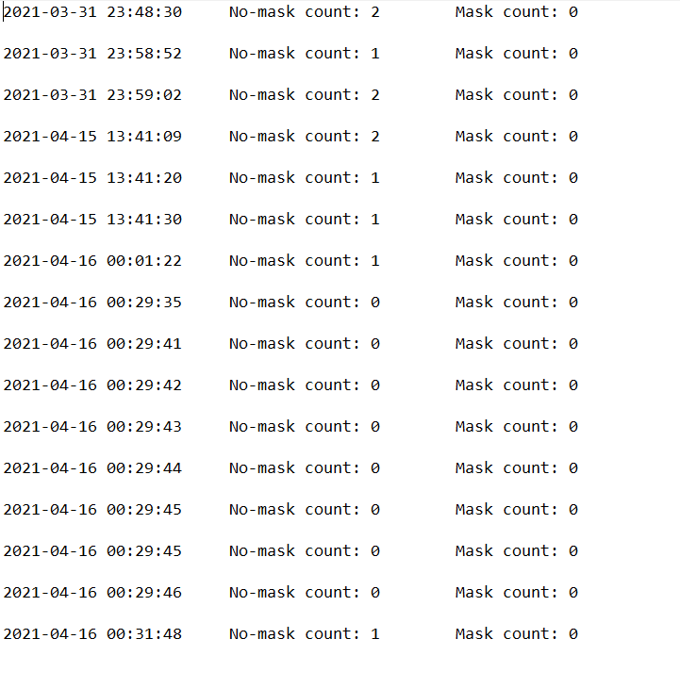
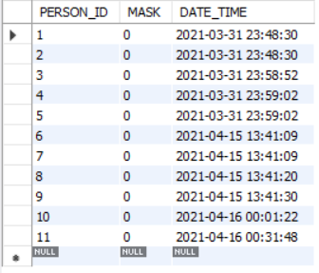
Database system
txt file
MySQL database
Speaker: PA

Slide 33
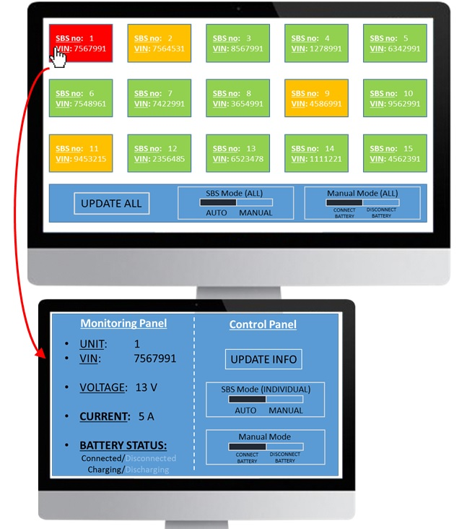
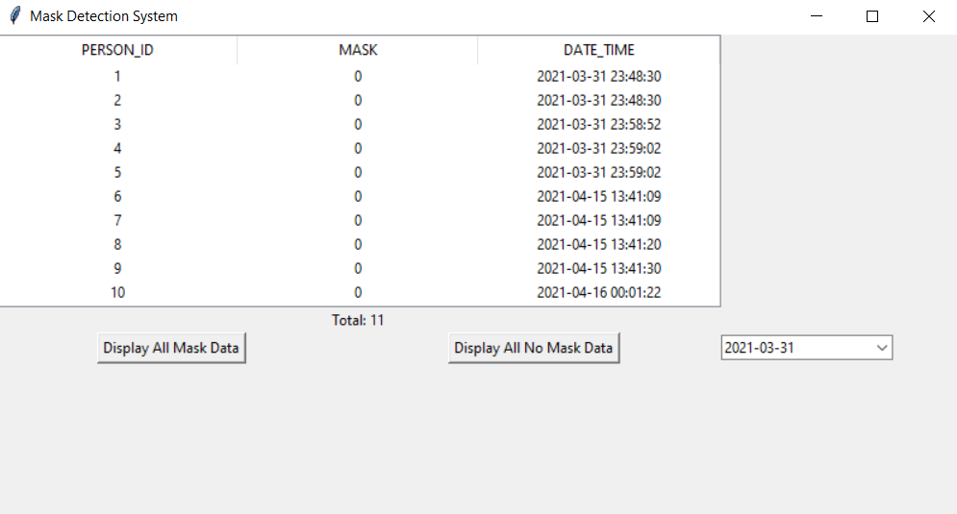
GUI application
Python GUI framework: Tkinter
Fast and easy to make functional GUI
User friendly app
Shows databases
Able to display data based on different date
Can be used for analytical purposes
Speaker: PA

Slide 34
Testing
Hardware Testing | Software Testing
Peripheral testing on breadboard | Camera Testing
Use voltmeter to test regulator circuit outputs | Mask Detection AI Testing
Use voltmeter to test each lead on PCB | Jetson Nano Deployment Testing
Use oscilloscope to test PWM on microcontroller | Jetson Nano GPIO Testing
 | Full System Testing
Speaker: Emanuel

Slide 35
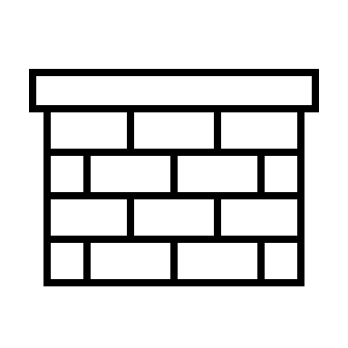
Project Analysis
Strengths:
Simplistic and low-cost design
Able to demonstrate knowledge we have learned
Aspirations:
Preventing the virus outbreak
Face mask detection system is more significant
Opportunities:
To develop highly accurate performance on facial detection
Able to help researchers about human behaviors and future disease “hotspot”
Results:
Following the project timeline
To provide user-friendly and operated automatically machine
To deliver best outcome within given time
Speaker: PA

Slide 36
Budget and Financial details
Components | Count | Total Cost | Acquired | Tested
L293D Motor Driver | 5 | $6.50 | Yes | Yes
PCB Manufacturing | 3 | $265 | Yes | Yes
128GB MicroSD Card | 1 | $23.39 | Yes | Yes
NVIDIA Jetson Nano Dev. Kit | 1 | $108.95 | Yes | Yes
IMX219 Camera Module | 1 | $21.77 | Yes | Yes
MSP430G2553IN20 | 5 | $9.2 | Yes | Yes
Wire and other Components | Varies | UCF Lab | No | Yes
HC-SR04 Ultrasonic Sensor | 1 | $3.95 | Yes | Yes
FLIR Lepton 3.5 Thermal Camera (Optional) | 1 | $200 | Yes / Returned (Jetson Nano inability to cope with multiple power-hungry programs running at once) | No
Servo Motor | 10 | $15.99 | Yes | Yes
Piezo Buzzer | 2 | $5.99 | Yes | No
Acrylic Sheets | 8 | $43.98 | Yes | No
Items purchased for old Power delivery design (Scrapped) | Varies | $58.91 | Yes | Yes
Subtotal | $563.63
Notes:
We initially wanted to add a thermal camera to the system, however, the jetson nano was unable to do multiple compute intensive tasks at once, which slowed the system down drastically. We returned the camera because of that
<<aside from that, skip over the rest>>

Slide 37
Milestone Chart
Speaker: PA
Notes:
Here is our milestone chart.

Slide 38
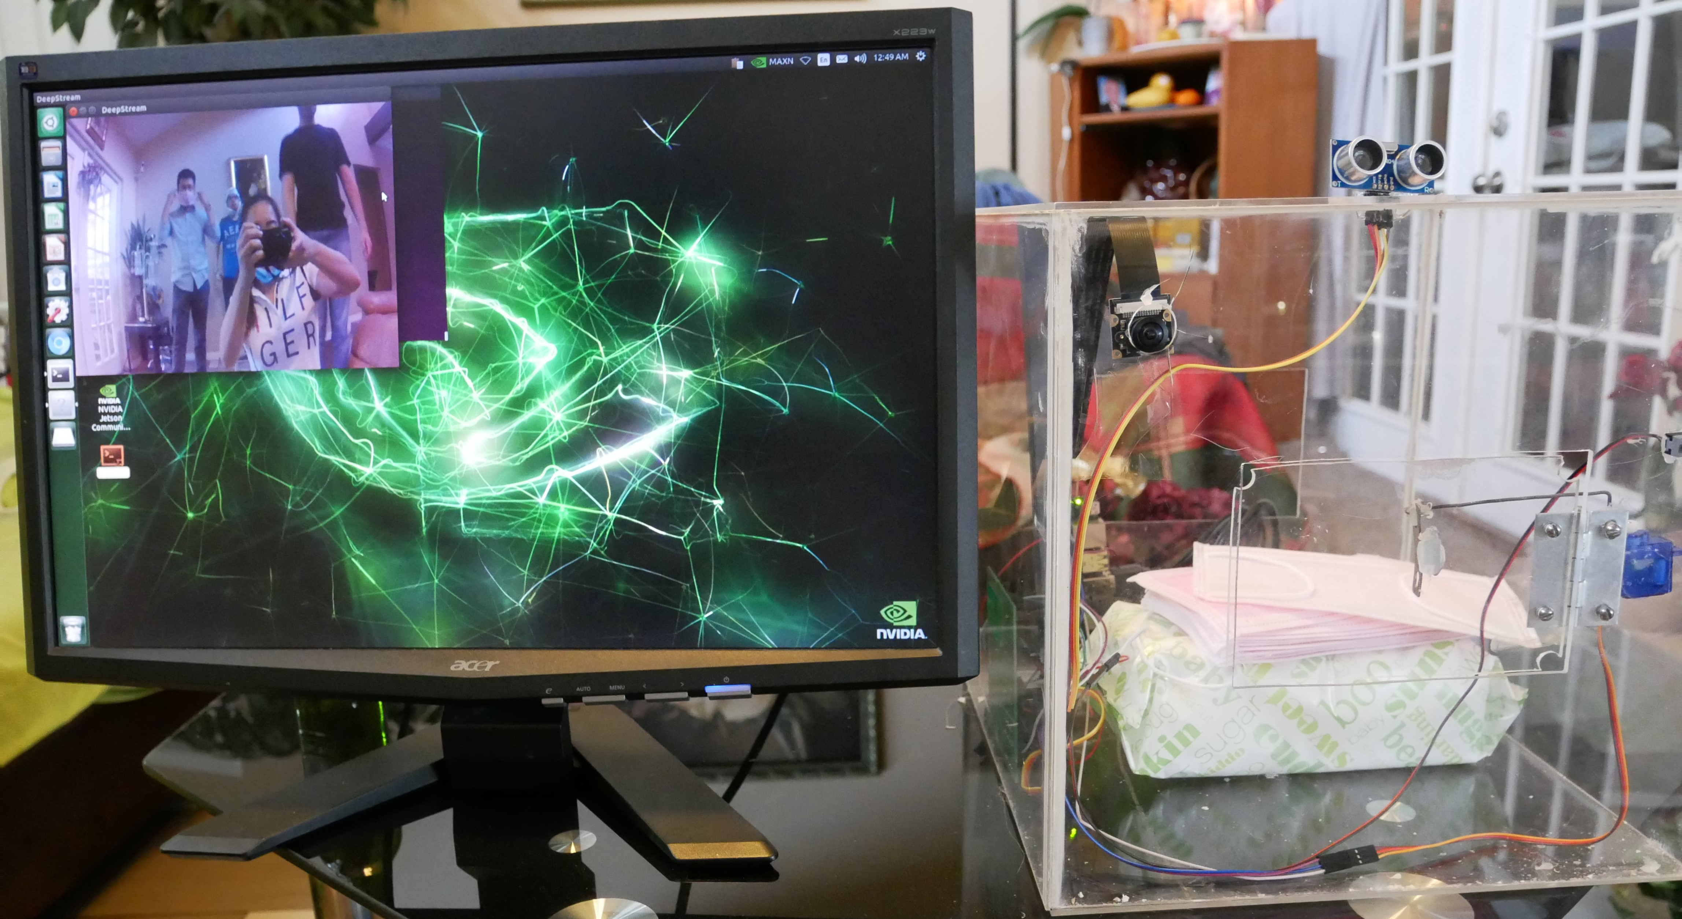
Final Product
Speaker: Emanuel

Slide 39
References

Slide 40
Questions?

